Slide 1
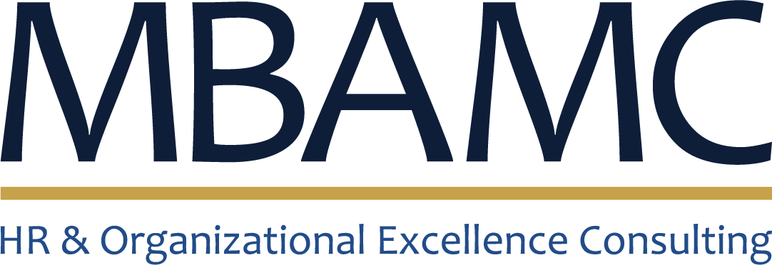
COMPANY PROFILE
Mohammed Bin Ayad
Management Consulting
HR & Organizational Excellence Consulting
Riyadh, Kingdom of Saudi Arabia · 2026

Slide 2
ABOUT MBAMC
Who We Are
MBAMC is a Riyadh-based management consulting practice specialising in human resources and organizational excellence. We help organizations design the systems that shape how people are rewarded, evaluated, organized and developed.
13+
Years of HR practice
since 2011
Founded by Mohammed Ayad Alsaedi — GRP and CIPD certified, with a Master's in HR Management — the practice draws on more than a decade of hands-on HR leadership at STC, Rezayat Group and Wala Plus.
12
Specialised service lines
Every engagement is delivered by a practitioner who has built and run these programs inside Saudi organizations, not just advised on them.
2
Global HR credentials
GRP · CIPD
MBAMC · Mohammed Bin Ayad Management Consulting
02

Slide 3
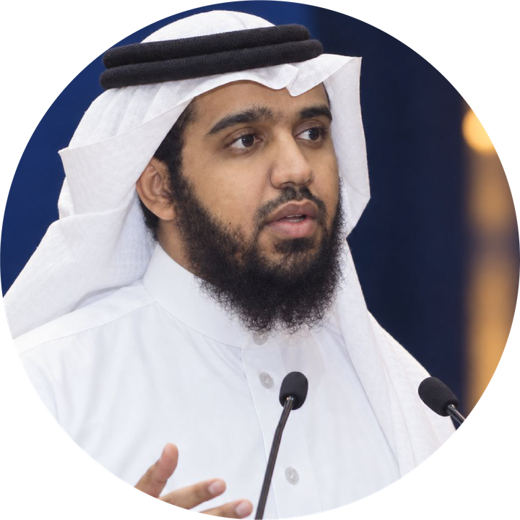




LEADERSHIP
Our Founder
An HR professional with more than a decade of expertise in organizational excellence, Mohammed has designed, implemented and led HR programs across telecom, diversified industrial and technology organizations in the Kingdom.
GRP — Global Remuneration Professional
WorldatWork, 2018
Mohammed Ayad Alsaedi
CIPD Level 3 Certification
GRP, CIPD
Oakwood International, 2015
Founder & Principal Consultant
Master's in Human Resource Management
Riyadh, Saudi Arabia
KFUPM, Dhahran
Current role
HR Planning & Analytics Manager, Group HR — Rezayat Group
MBAMC · Mohammed Bin Ayad Management Consulting
03

Slide 4
FOUNDER'S JOURNEY
A Career Built Inside Saudi Organizations
2011 – 2018
2018 – 2021
2021 – 2023
2023 – Present
STC
Rezayat Group
Wala Plus
Rezayat Group
Rewards & Performance
Organization Development Specialist
HR Manager → Org. Excellence Manager
HR Planning & Analytics Manager
HR Officer → Policies & Rewards Analyst → Rewards Specialist. Salary structures, allowances, incentives and HR policy at the Kingdom's largest telecom.
Org structures and workforce plans for Group companies; owned the Group Job Family Model and the annual appraisal cycle.
Built the HR function, then linked company strategy, GRC and KPIs to department and employee performance.
Group HR strategy, executive HR advisory, HR automation, and dashboards & insight reporting for top management.
MBAMC · Mohammed Bin Ayad Management Consulting
04

Slide 5





WHERE WE GO DEEP
Areas of Expertise
Total Rewards
Performance Management
Employee Value Proposition
HR Policies & Procedures
Organization Development
Pay structures, allowances, incentives and benefits that attract and retain.
Appraisal systems and KPI cascades that link strategy to individual results.
Defining and delivering what makes your organization worth joining and staying.
Documented, compliant and practical frameworks that people actually use.
Structures, job families and workforce plans built for scale.
MBAMC · Mohammed Bin Ayad Management Consulting
05

Slide 6


TWELVE SERVICE LINES ACROSS THREE PRACTICE AREAS
Our Services
Total Rewards
Performance & Organization
HR Foundations
Salary Structures
Employee Performance Management
HR Policies & Procedures
Allowances
Job Descriptions
Establishing the HR Function
Commission & Incentive Schemes
Organization Structures
Coaching & Mentoring
Employee Benefits
Workforce Planning
HR Advisory for Leadership
MBAMC · Mohammed Bin Ayad Management Consulting
06

Slide 7




WHAT SETS THE PRACTICE APART
Why MBAMC
Practitioner-led
Globally certified
Advice from someone who has built salary structures, appraisal cycles and HR functions in-house — and lived with the results.
GRP from WorldatWork and CIPD-certified, applying international reward and people standards to local realities.
Academically grounded
Saudi market depth
A Master's in HR Management from KFUPM (GPA 3.79) underpins every framework with rigour, not just experience.
Over a decade across STC, Rezayat Group and Wala Plus — telecom, industrial and tech, all in the Kingdom.
MBAMC · Mohammed Bin Ayad Management Consulting
07

Slide 8





ENGAGEMENT APPROACH
How We Work
01
02
03
04
Diagnose
Design
Deploy
Sustain
Review current policies, structures and pay practices; interview leadership; benchmark against the market.
Build the framework — structures, schemes, policies or job families — sized to your budget and growth plan.
Implement with leadership, line managers and HR; configure systems and communicate change.
Coach the HR team, hand over governance and review results against agreed KPIs.
MBAMC · Mohammed Bin Ayad Management Consulting
08

Slide 9
CERTIFICATIONS AND SPECIALIST TRAINING
Credentials & Professional Development
Education
Certifications & Training
Master of Human Resource Management
2018
Global Remuneration Professional (GRP)
WorldatWork
King Fahd University of Petroleum & Minerals
2015
CIPD Level 3 Certification
Oakwood International
2015
Analyzing & Documenting Policies & Procedures
Informa
2014
Rewards Academy
Aon Hewitt
Bachelor of Management
King Fahd University of Petroleum & Minerals
2013
Project Management Professional (PMP) sessions
STC
2011
2012
Advanced Organization Design
Ashridge University
MBAMC · Mohammed Bin Ayad Management Consulting
09

Slide 10




LET'S TALK
Ready to strengthen how your organization rewards, evaluates and grows its people?
+966 55 098 6699
mohammed.ayad@mbamc.com
mbamc.com
sa.linkedin.com/in/mohammedalsaedi-486a7731
Mohammed Ayad Alsaedi, GRP, CIPD
Founder & Principal Consultant
MBAMC · Mohammed Bin Ayad Management Consulting · Riyadh, Saudi Arabia

